Slide 1
Day 2 – Azure Machine Learning Development
BRK07 - Azure Machine Learning no-code development (40 min)
LAB02 – Implementing ML pipelines with the designer
BRK08 – Automated Machine Learning (AutoML) (45 min)
ACT03 – DISCUSS: Use cases for AutoML
BRK09 – Azure Machine Learning SDK for Python (30 min)
LAB03 – Implementing and monitoring a batch scoring solution
BRK10 – Azure CLI extension for Azure Machine Learning (60 min)
LAB04 – Deploying a real-time scoring endpoint with managed compute

Slide 2
BRK07 – Azure Machine Learning no-code development
<Presenter name>
<Presenter title>

Slide 3
Agenda

Slide 4












AML Pilot Architecture DEV Environment
APPLICATION INSIGHTS
KEY VAULT
STORAGE
ACCOUNT
MODEL TRAINING
MLOPS
AZURE ML COMPUTE
AZURE ML NOTEBOOKS
AZURE ML PIPELINES (Python Scripts)
AZURE
PIPELINES
GITHUB
(Repo)
AZURE ML (Experiments & Models)
DATA PROCESSING / SCORING
STORAGE
PRIVATE ENDPOINT
KEY VAULT
PRIVATE ENDPOINT
CONTAINER REGISTRY
PRIVATE ENDPOINT
AZURE ML NOTEBOOKS
AZURE ML PIPELINES (Python Scripts)
AZURE ML
PRIVATE ENDPOINT
SERVING STORAGE
CLIENT WORKSTATION
(Jump box, VPN or ExpressRoute)
SQL DB
DATA LAKE STORE

Slide 5
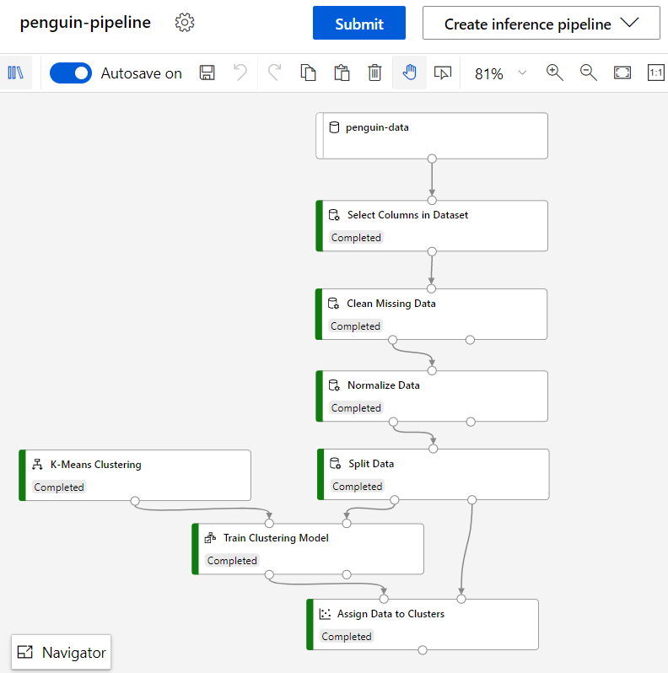
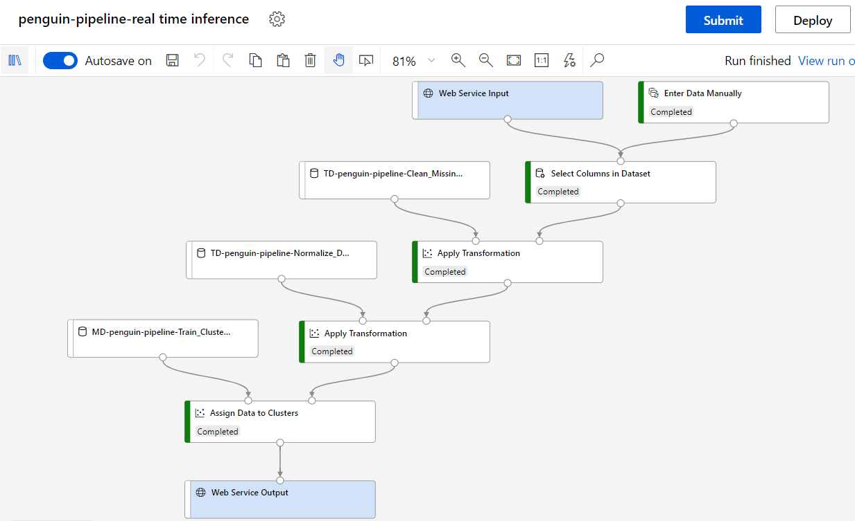
What is a Pipeline?
The working metaphor for Azure Machine Learning
Training pipelines to train models
Inference pipelines to generate predictions
Real-time inference
Batch inference

Slide 6
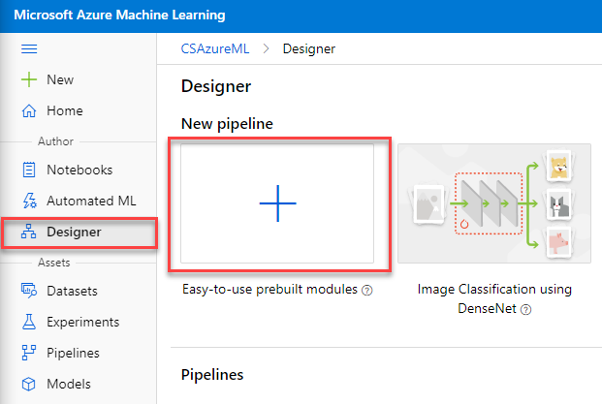
Creating a New Pipeline
Create a pipeline through the Azure ML studio or via API using a language like Python, R, C#, or F#.

Slide 7
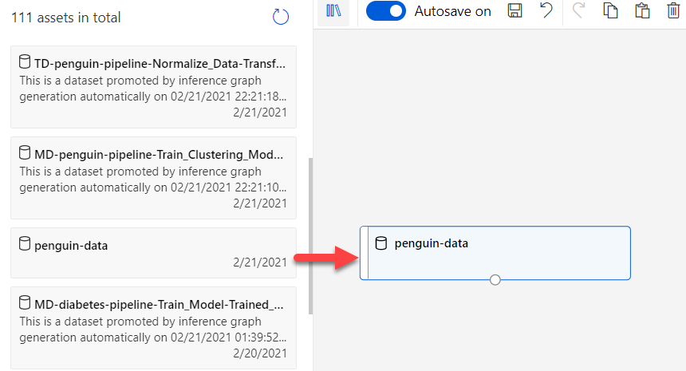
Modifying a Pipeline
The Azure Machine Learning Studio includes a drag-and-drop interface. Bring pipeline components onto the canvas.

Slide 8
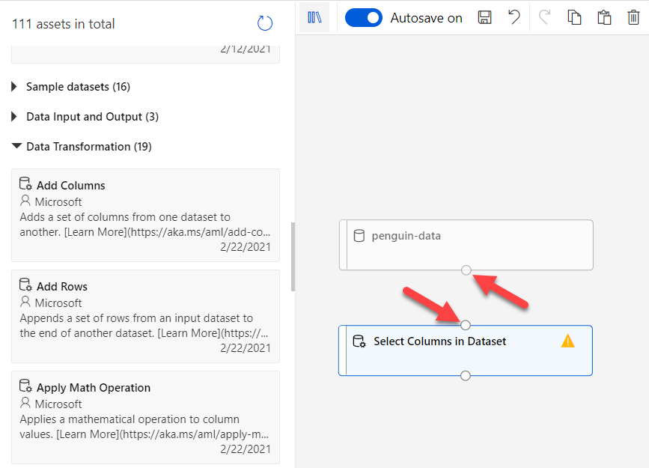
Modifying a Pipeline
Then, connect them together.
Each connector is of a specific class, such as DataFrameDirectory or TransformationDirectory. Pipeline components can only connect if the classes match.

Slide 9
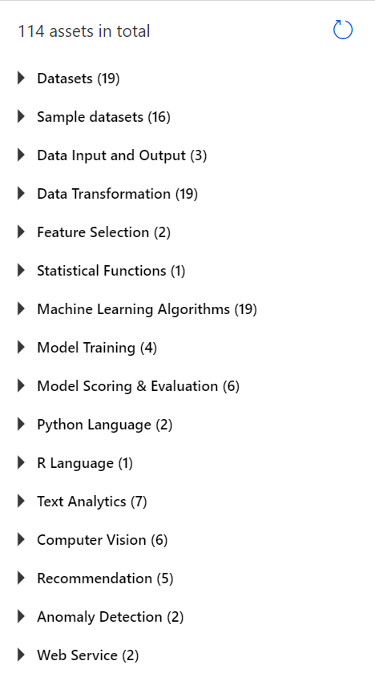
Built-In Components
Azure Machine Learning features a variety of built-in components.

Slide 10
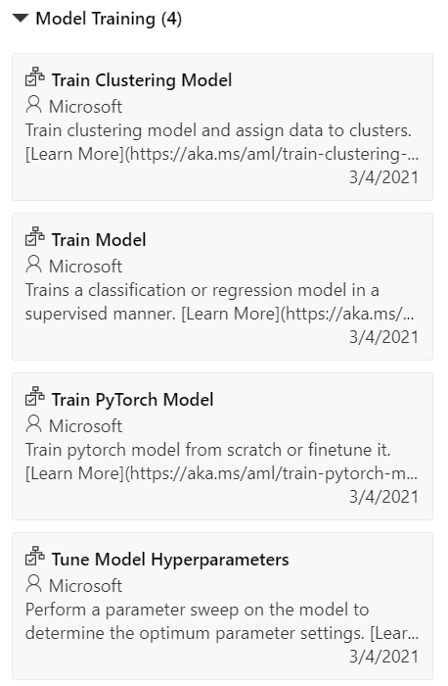
Built-In Components
Model training includes training the following sorts of models:
Regression
Classification
Clustering
Image classification
Anomaly detection
Recommendation (SVD and Wide & Deep)

Slide 11
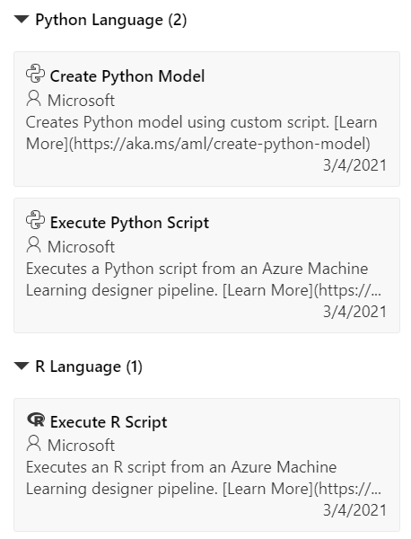
Custom Components
Build out components in R or Python. This includes installing custom packages.

Slide 12
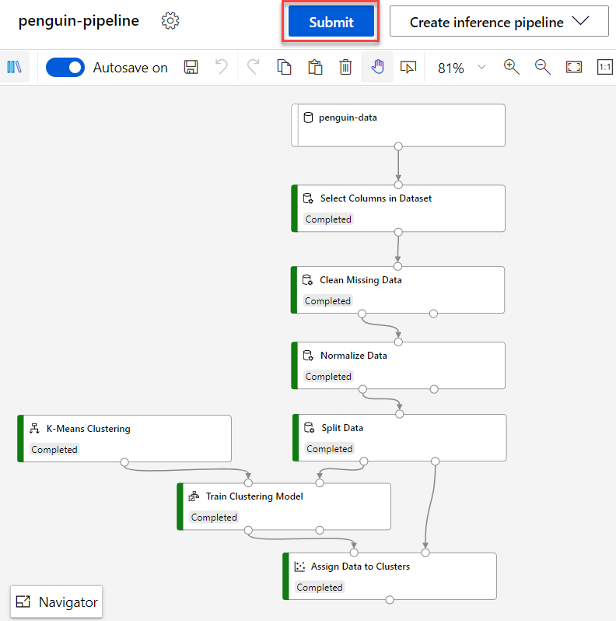
Training a Model
Train models at the click of a button.

Slide 13
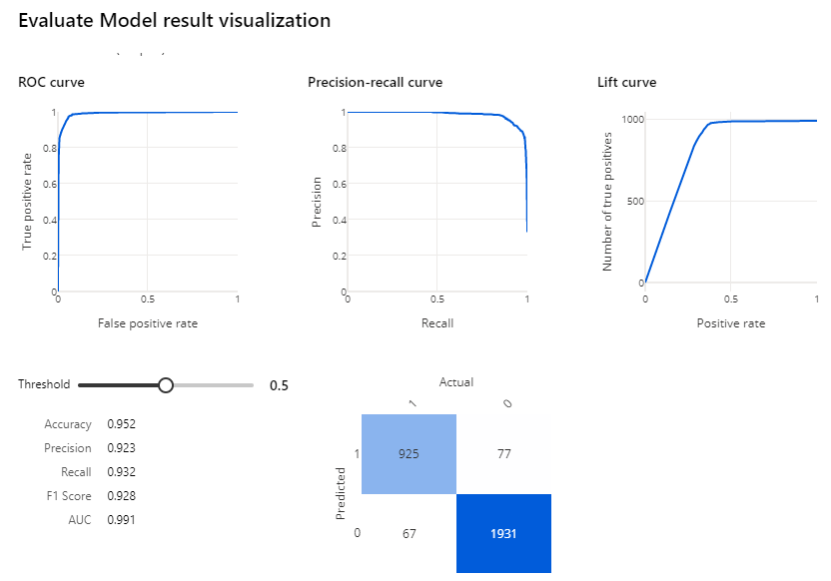
Evaluating a Model
Regression and classification models include UI components for evaluation.
Regression includes statistics such as R^2, MAE, MAPE, and RMSE.
Classification includes the confusion matrix and calculations off of it, such as accuracy, precision, and recall.
Two-class classification models include ROC curves and Area Under the Curve.

Slide 14
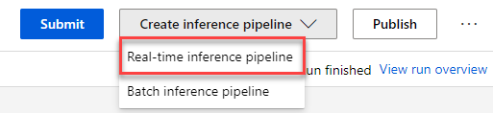
Creating an Inference Pipeline
Create an inference pipeline with a few clicks. Two types are available:
Real-time inference pipeline
Batch inference pipeline
Real-time inference pipelines operate via web service and return results for one or a few observations.
Batch inference pipelines typically write results to files or databases and operate asynchronously.

Slide 15
Creating an Inference Pipeline
Create an inference pipeline with a few clicks. Two types are available:
Real-time inference pipeline
Batch inference pipeline
Real-time inference pipelines operate via web service and return results for one or a few observations.
Batch inference pipelines typically write results to files or databases and operate asynchronously.

Slide 16
Deploying an Inference Pipeline
Deploy a pipeline with a click of a button.
The end result is a web service available via REST call.

Slide 17
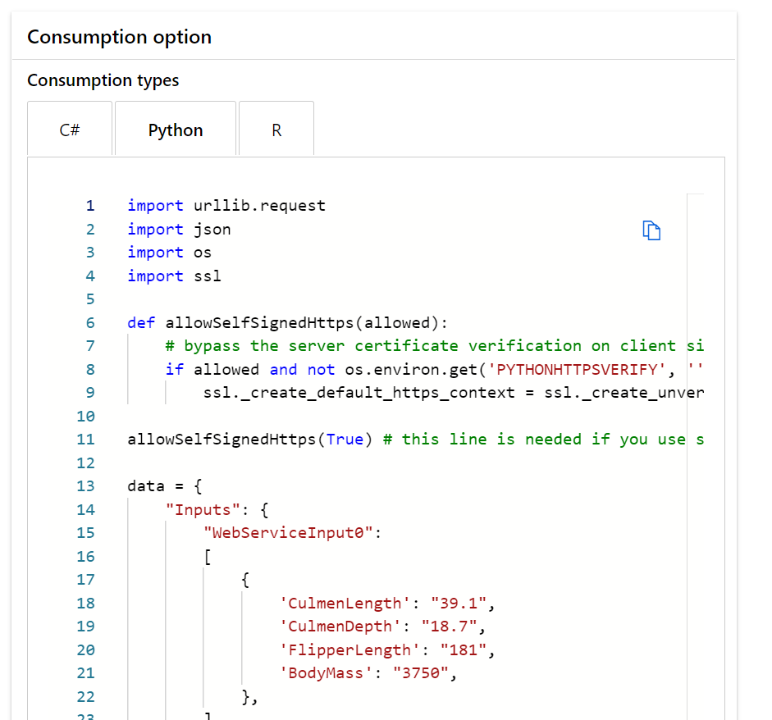
Consuming the Endpoint
Consume the endpoint via HTTP. Instructions are available for C#, Python, and R, but other languages work too.

Slide 18
BRK08 – Automated Machine Learning (AutoML)
<Presenter name>
<Presenter title>

Slide 19
Agenda

Slide 20
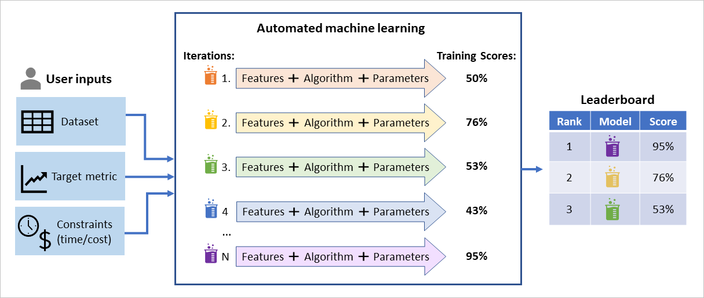
Automated ML
Automates the exploration of feature engineering approaches, algorithm selection and model parameters to produce the best performing ML model.
Saves you time and gives you a head-start.
Key Scenarios:
Deployment Options:
Classification
Forecasting
Regression
Notebook
ONNX
Web Service
*Not suitable outside of these scenarios.
Best model
*Not all algorithms support ONNX export.
Data Shape Required:
Tabular (Text + Numeric)
Time Series
Tabular (Numeric)
Feature Engineering:
Algorithms (count):
Scaling/Normalization
Dimensionality Reduction
Encoding
Classification (14)
Regression (12)
Forecasting (17)
*Includes Regressors, Trees, Ensembles & Deep Neural Networks

Slide 21
BRK09 – Azure Machine Learning SDK for Python
<Presenter name>
<Presenter title>

Slide 22
Agenda

Slide 23
Azure Machine Learning pipelines (Overview)
Pipeline: distinct steps to facilitate model training, deployment, and inference
Use the Azure Machine Learning SDK for Python
Prepare Data
Build & Train Models
Deploy & Predict
Data
Ingestion
Data Snapshots (versioning)
Data
Preparation
Model Building
& Training
Model
Deployment
Normalization
Hyper-parameter
tuning
Deployment
Transformation
Automatic model
selection
Batch scoring
Validation
Model testing
Data storage
locations
Featurization
Model validation

Slide 24
Create AML Compute
Provision and manage clusters of Azure VMs for running ML workloads
Needed to execute pipelines
Can re-use compute clusters across ML jobs or create new clusters per job
provisioning_config = AmlCompute.provisioning_configuration( vm_size = "STANDARD_D2_V2", min_nodes = 1, max_nodes = 1)
aml_compute = ComputeTarget.create( ws, aml_compute_target, provisioning_config)

Slide 25
Create Run Configuration
Use the created compute target
Set container details
run_amlcompute = RunConfiguration()
run_amlcompute.target = aml_compute_target
run_amlcompute.environment.docker.enabled = True
run_amlcompute.environment.docker.base_image = DEFAULT_CPU_IMAGE
run_amlcompute.environment.python.user_managed_dependencies = False
run_amlcompute.environment.python.conda_dependencies = CondaDependencies.create(pip_packages=[
'numpy',
'pandas',
'scikit-learn',
'sklearn_pandas'
])
If True, use your own installed packages instead of Conda
Specify packages to install

Slide 26
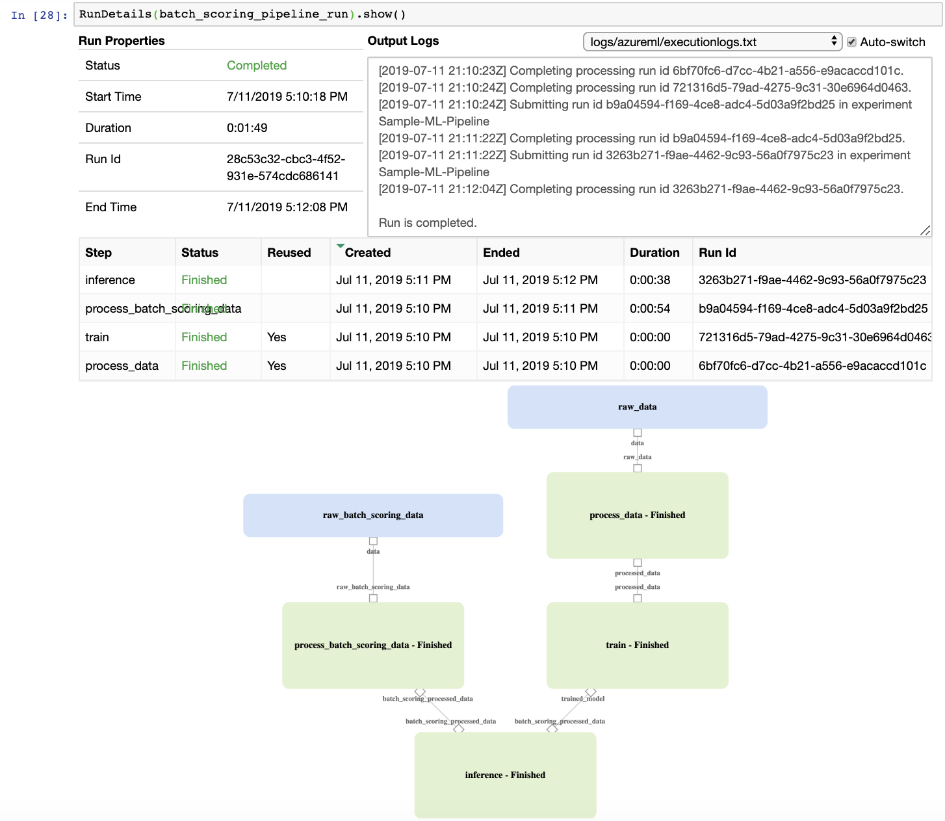
Walkthrough: Creating a Pipeline

Slide 27
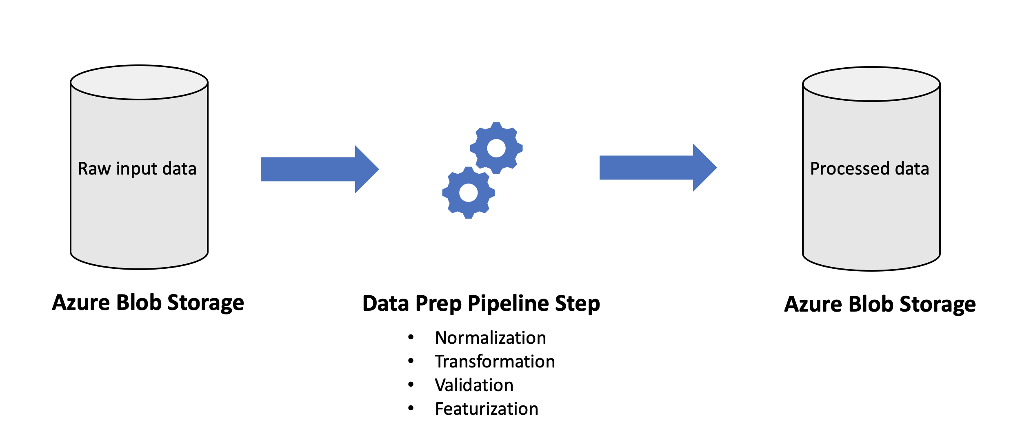
Create Data Prep Step

Slide 28
Create Data Reference
from azureml.data.data_reference import DataReference
def_blob_store = ws.get_default_datastore()
raw_data = DataReference(
datastore=def_blob_store,
data_reference_name="raw_data",
path_on_datastore=".../...")
The input to our Data Prep Pipeline step

Slide 29
Create Pipeline Data for Prepared Data
from azureml.pipeline.core import PipelineData
processed_data = PipelineData(
'processed_data’,
datastore=def_blob_store)
An intermediate data object tying an output to the next input

Slide 30
Create Data Prep Step
Three input arguments: train/inference, input loc, output loc
Path to your Python script named process.py
dataPrepStep = PythonScriptStep(
name="process_data",
source_directory="...",
script_name="process.py",
arguments=["--process_mode", 'train',
"--input", raw_data,
"--output", processed_data],
inputs=[raw_data],
outputs=[processed_data],
compute_target=aml_compute,
runconfig=run_amlcompute
)
Specify the input and output objects
Specify the compute and config choices

Slide 31
Viewing process.py
# Parse arguments: process_mode, input, output
data = pd.read_csv(args.input)
if(args.process_mode == 'train’): ...
elif(args.process_mode == 'inference’): ...
else:
print('Invalid process_mode!')
os.makedirs(args.output, exist_ok=True)
data.to_csv(os.path.join(args.output, "processed-data.csv"), header=True, index=False)
Read in input data given a file path
Use something like argparser to help with parameter values
Raw inference data won’t include labels, so behavior changes!
After processing, write to output loc

Slide 32
Create Model Training Step
trained_model = PipelineData('trained_model', datastore=def_blob_store)
trainStep = PythonScriptStep(
name="train",
source_directory="...",
script_name="train.py",
arguments=["--input", processed_data, "--output", trained_model],
inputs=[processed_train_data],
outputs=[trained_model],
compute_target=aml_compute,
runconfig=run_amlcompute
)
Build a new PipelineData to hold the step output
Locate and process train.py
processed_data was our prior step’s output
Use the same compute and config

Slide 33
Run the Training Pipeline
Build a pipeline, tying together the prior steps
from azureml.pipeline.core import Pipeline
from azureml.core import Experiment
pipeline = Pipeline(workspace=ws, steps=[trainStep])
pipeline.validate()
experiment_name = 'Sample-ML-Pipeline'
pipeline_run = Experiment(ws, experiment_name) .submit(pipeline)
RunDetails(pipeline_run).show()
Simple validation: check for unconnected inputs, etc.
Create an experiment and execute the pipeline
Show the status of the pipeline

Slide 34
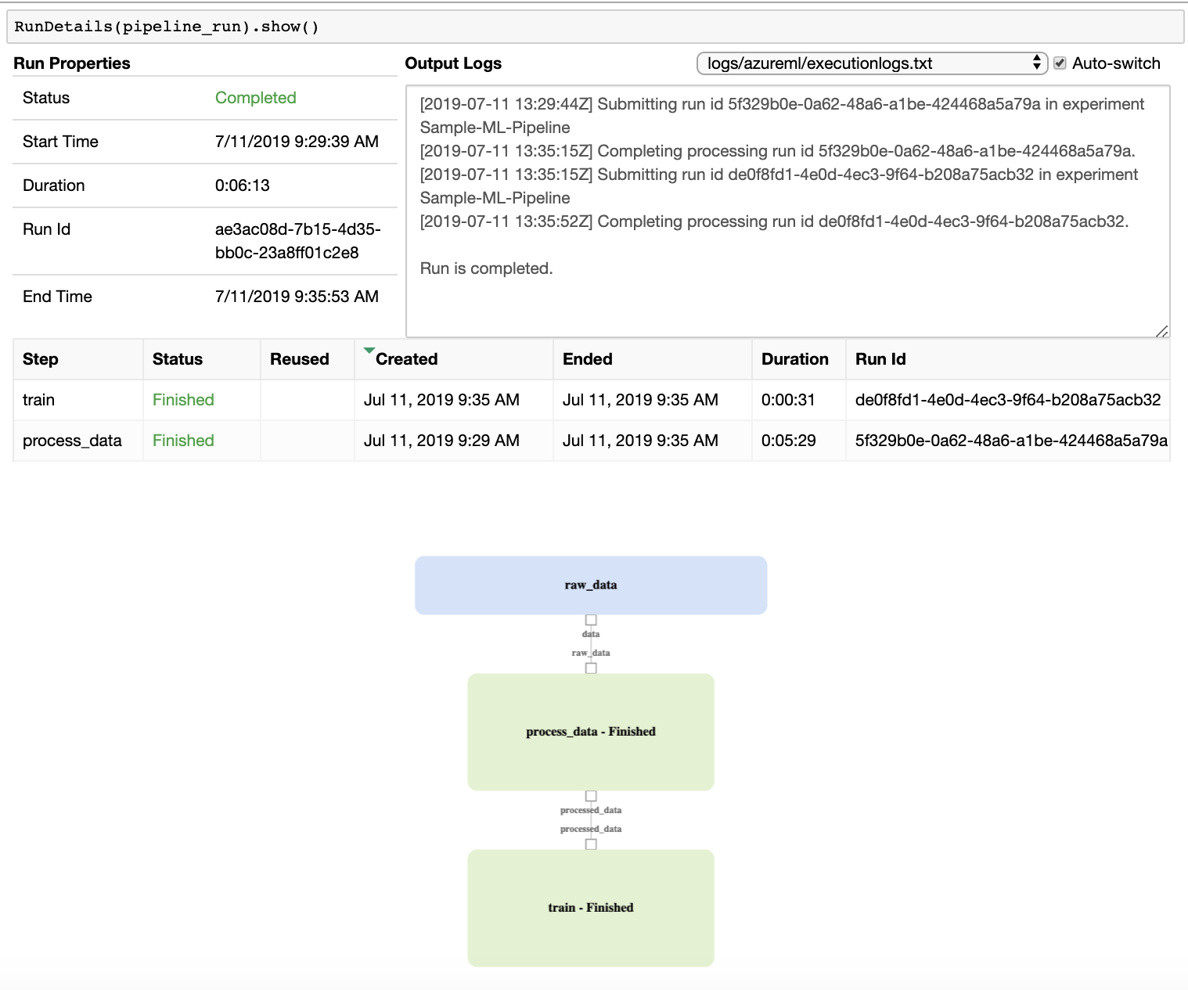

Slide 35
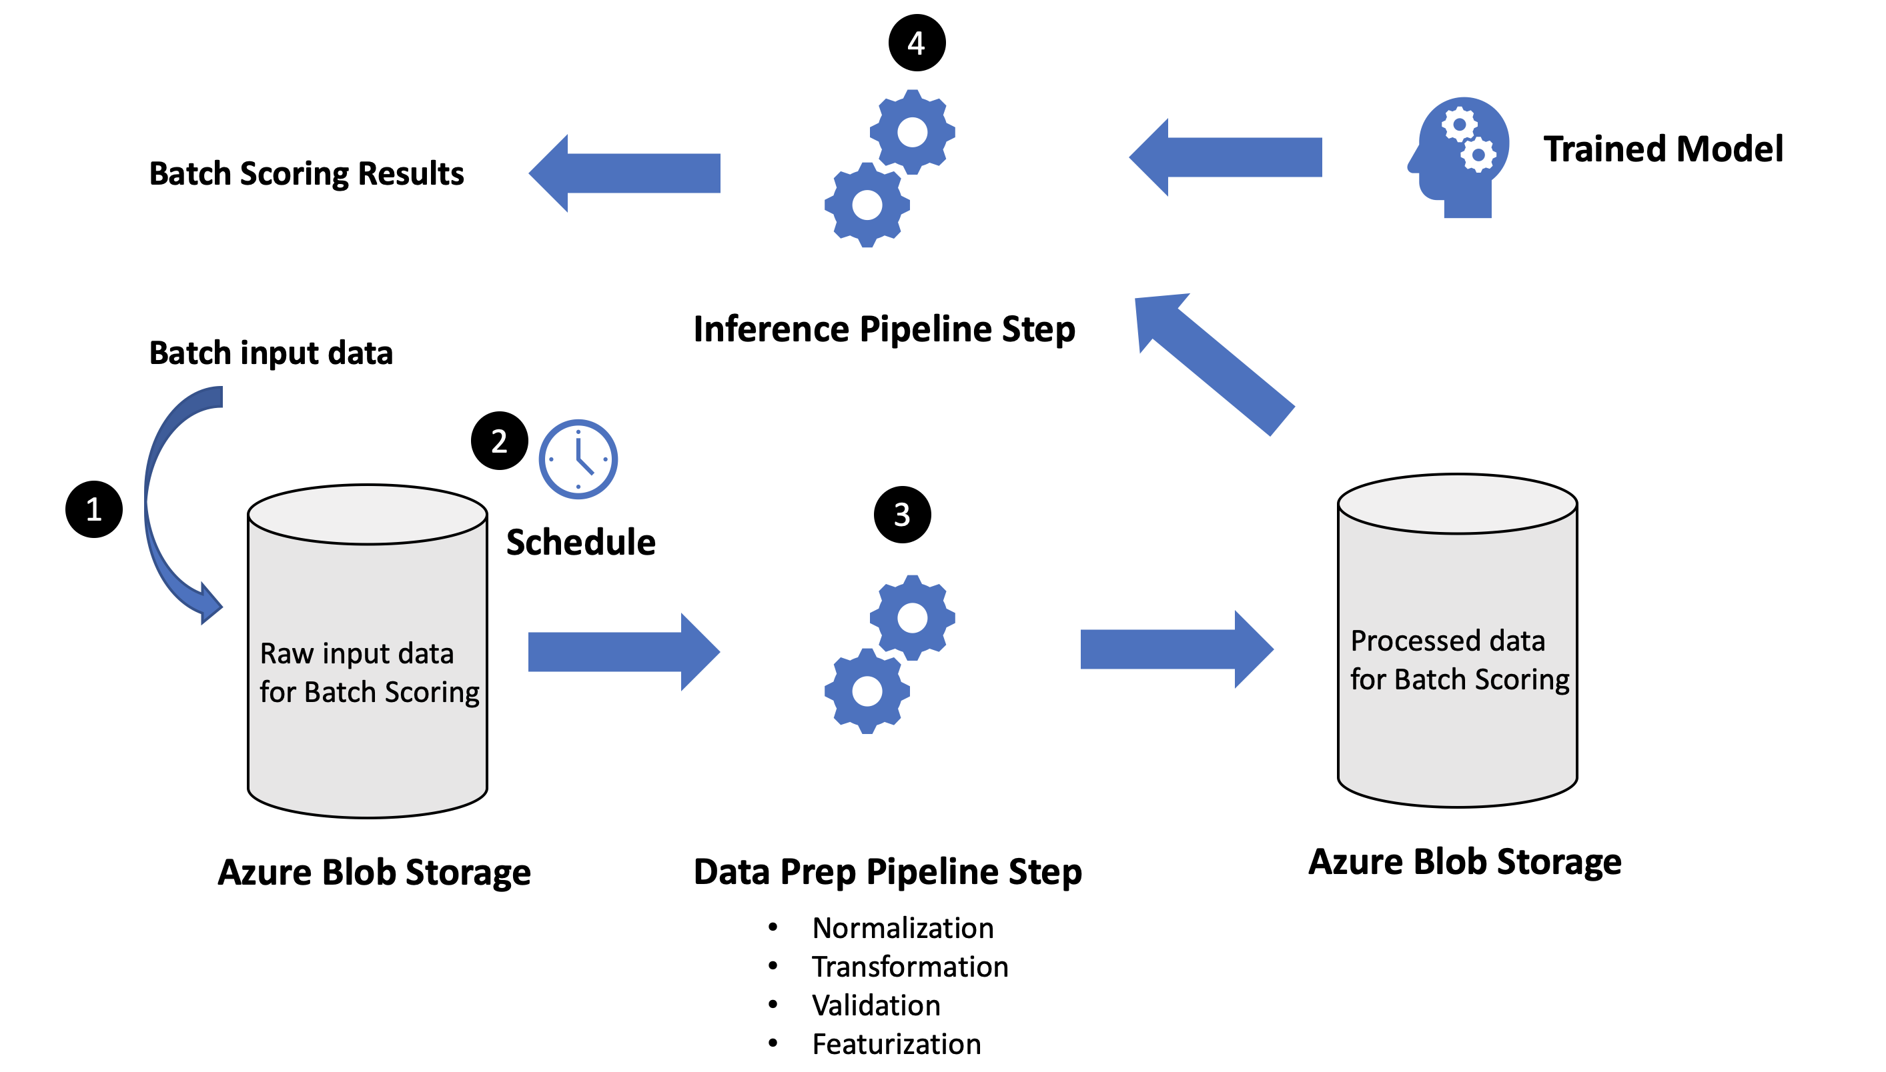
Create the Batch Scoring Pipeline

Slide 36
Create the Batch Scoring Pipeline
raw_batch_scoring_data = DataReference(
datastore=def_blob_store,
data_reference_name="raw_batch_scoring_data",
path_on_datastore=".../...")
batch_scoring_processed_data = PipelineData('batch_scoring_processed_data', datastore=def_blob_store)
Locate the batch data to process
Generate a post-processing output for the pipeline

Slide 37
Create the Batch Scoring Pipeline
Three input arguments: train/inference, input loc, output loc
Path to the same process.py file as in training
batchDataPrepStep = PythonScriptStep(
name="process_batch_scoring_data",
source_directory="...",
script_name="process.py",
arguments=["--process_mode", 'inference',
"--input", raw_batch_scoring_data,
"--output", batch_scoring_processed_data],
inputs=[raw_batch_scoring_data],
outputs=[batch_scoring_processed_data],
allow_reuse = False,
compute_target=aml_compute, runconfig=run_amlcompute)
Specify the input and output objects
Can the step use previous results when re-run with the same settings?

Slide 38
Create the Batch Scoring Pipeline
batch_scoring_results = PipelineData('batch_scoring_results', datastore=def_blob_store)
inferenceStep = PythonScriptStep(
name="inference",
source_directory="...",
script_name="inference.py",
arguments=["--input", batch_scoring_processed_data,
"--model", trained_model,
"--output", batch_scoring_results],
inputs=[batch_scoring_processed_data, trained_model],
outputs=[batch_scoring_results],
compute_target=aml_compute,
runconfig=run_amlcompute)
Inference file (not shown) loads model & data, predicts, and saves in batch_scoring_results
Build the output pipeline data object

Slide 39
Publish Batch Scoring Pipeline
batch_scoring_pipeline = Pipeline(workspace=ws, steps=[inferenceStep])
batch_scoring_pipeline.validate()
pipeline_name = 'Batch Scoring Pipeline'
published_pipeline = batch_scoring_pipeline.publish(name = pipeline_name)
Build a pipeline for inference
Simple validation: check for unconnected inputs, etc.
Publish the pipeline, making it available to run on demand

Slide 40
Schedule Batch Scoring Pipeline
from azureml.pipeline.core.schedule import Schedule
schedule = Schedule.create( workspace=ws, name=pipeline_name + "_sch", pipeline_id=published_pipeline.id, experiment_name=experiment_name, datastore=def_blob_store, wait_for_provisioning=True, description=“Scheduler for Pipeline: " + pipeline_name, path_on_datastore="...", polling_interval=1 )
Create a schedule for an experiment to run a pipeline
Monitor the datastore for changes
Folder where the new input data is uploaded
Polling interval in minutes

Slide 41
Schedule Batch Scoring Pipeline
batch_scoring_pipeline_run = schedule.get_last_pipeline_run()
RunDetails(batch_scoring_pipeline_run).show()

Slide 43
BRK10 – Azure CLI extension for Azure Machine Learning
<Presenter name>
<Presenter title>

Slide 44
Agenda

